Slide 1
Advanced Machine Learning
BY
Adnan Amin

Slide 2
Train vs. Validation vs. Test set

Slide 3
1. The Training Set

Slide 4
Model Evaluation & Validation

Slide 5
Why Model Evaluation?
To determine:
overlearned model
it could give us a good accuracy value for the training data but may do poorly on new (test) data.
Complex model
it could become hard to generalize or explain even though it performs well.
Measures of success and effectiveness of the model.
It could help us in comparison of various models.

Slide 6
Confusion Matrix How To Use It & Interpret

Slide 7
Evaluation measures
Confusion matrix
True positive
True negative
False positive
False negative
Precision, recall, F1-Score, Accuracy

Slide 8
Confusion Matrix: Cont.
Evaluating the performance of a machine learning model.
A matrix of numbers that tell us where a model gets confused. It is a class-wise distribution of the predictive performance of a classification model.
Types of Confusion Matrix:
Confusion Matrix for Binary Classes
Confusion Matrix for Multiple Classes

Slide 9
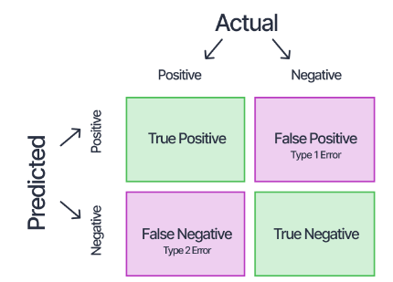
Confusion Matrix for Binary Classes
A sample belonging to the positive class being classified correctly.
A sample belonging to the negative class but being classified wrongly as belonging to the positive class.
A sample belonging to the positive class but being classified wrongly as belonging to the negative class.
A sample belonging to the negative class being classified correctly.

Slide 10
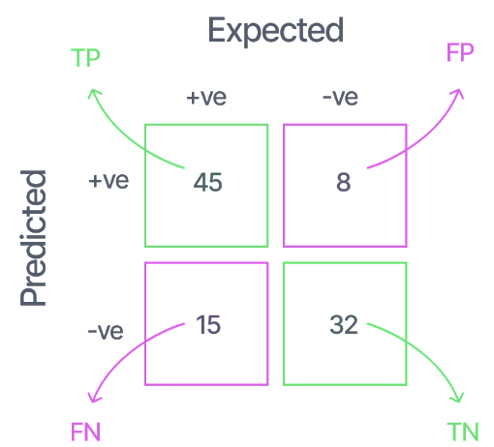
Confusion Matrix Interpretation
8 samples were expected to be of negative class but were classified as “positive” by the model. They are thus called “False Positives.”
45+8=53
15+32=47
15 samples that were expected to be of the positive class were classified as the negative class by the model. It is called “False Negatives” because the model predicted “negative,” which was wrong.
45+15=60
8+32=40
45+32=77
The correct classifications are the diagonal elements of the matrix

Slide 11
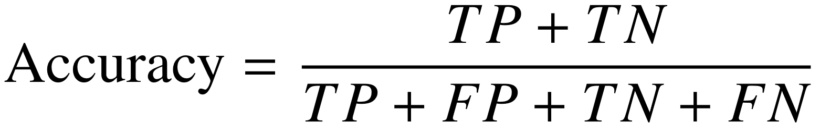
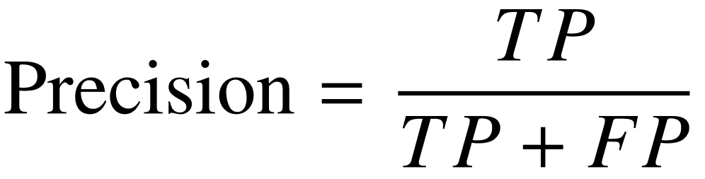
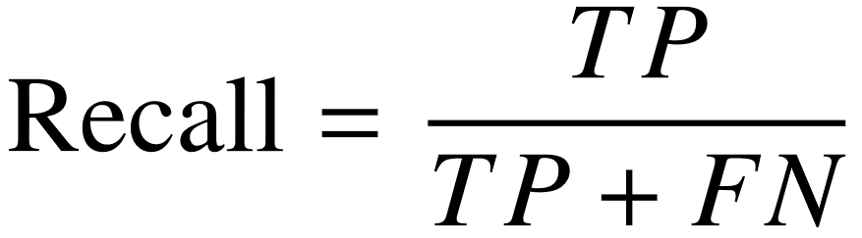
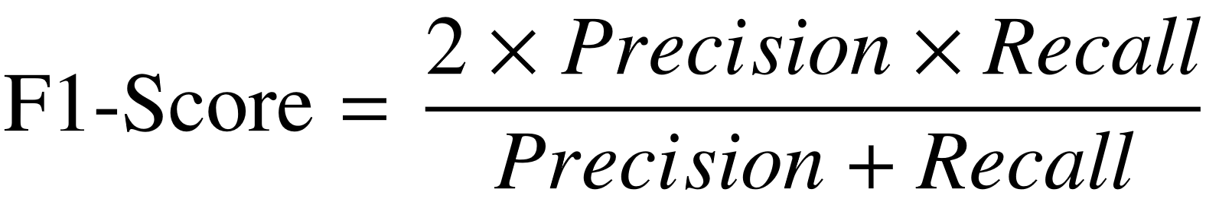
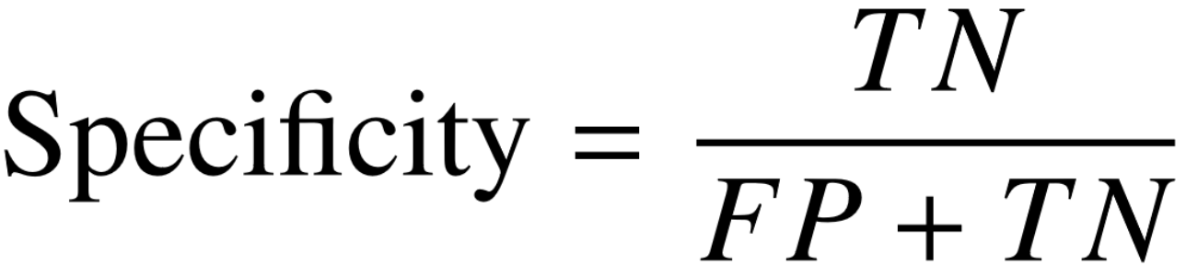
State-of-the-art Evaluation measures
The number of samples correctly classified out of all the samples present in the test set.
(For Positive Class): The number of samples actually belonging to the positive class out of all the samples that were predicted to be of the positive class by the model.
(For Positive Class): The number of samples predicted correctly to be belonging to the positive class out of all the samples that actually belong to the positive class.
(For Positive Class): The harmonic mean of the precision and recall scores obtained for the positive class.
The number of samples predicted correctly to be in the negative class out of all the samples in the dataset that actually belong to the negative class.

Slide 12
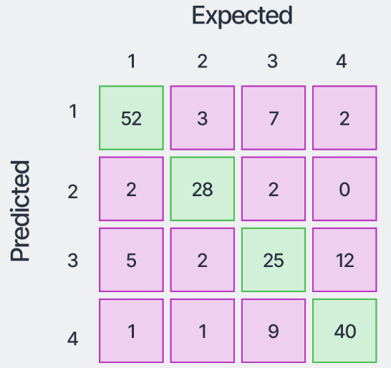
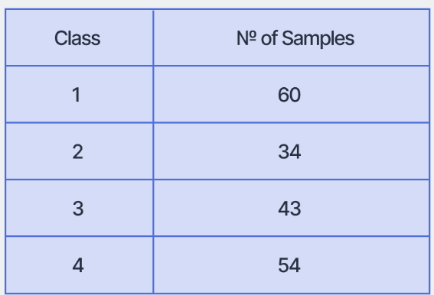
Confusion Matrix for Multiple Classes
Suppose we have the test set (consisting of 191 total samples) of a dataset with the following distribution:
Assume the confusion matrix obtained by training a classifier and evaluating the trained model on this test set

Slide 13
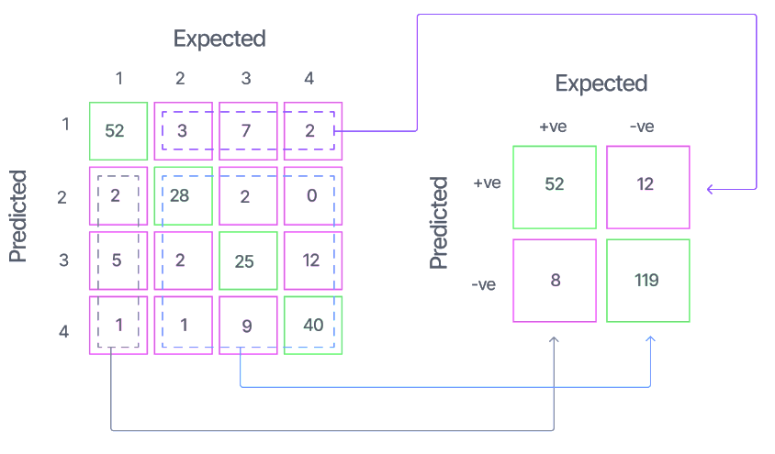
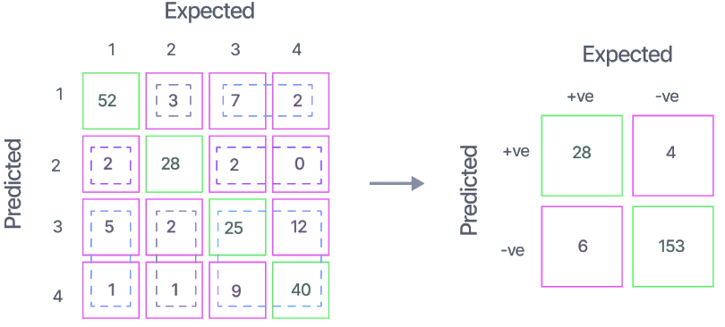
Convert the confusion matrix into a one-vs-all.
one-vs-all matrix for class-1
one-vs-all matrix for class-2

Slide 14
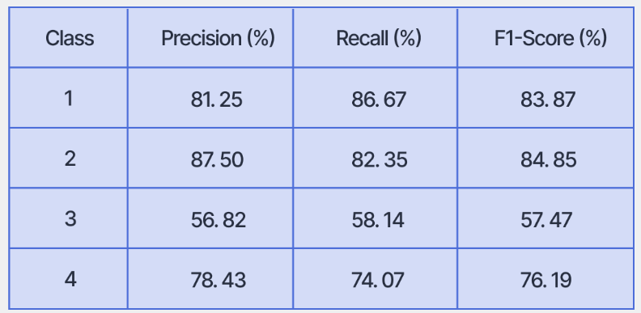
Performance Evaluation of the Model

Slide 15
Micro F1-Score
The micro-averaged f1-score is a global metric that is calculated by considering the net TP, i.e., the sum of the class-wise TP (from the respective one-vs-all matrices), net FP, and net FN. These are obtained to be the following:
Net TP = 52+28+25+40 = 145 Net FP = (3+7+2)+(2+2+0)+(5+2+12)+(1+1+9) = 46 Net FN = (2+5+1)+(3+2+1)+(7+2+9)+(2+0+12) = 46
Note that for every confusion matrix, the net FP and net FN will have the same value. Thus, the micro precision and micro recall can be calculated as:
Micro Precision = Net TP/(Net TP+Net FP) = 145/(145+46) = 75.92% Micro Recall = Net TP/(Net TP+Net FN) = 75.92%
Thus, Micro F-1 = Harmonic Mean of Micro Precision and Micro Recall = 75.92%.
Since all the measures are global, we get: Micro Precision = Micro Recall = Micro F1-Score = Accuracy = 75.92%

Slide 16
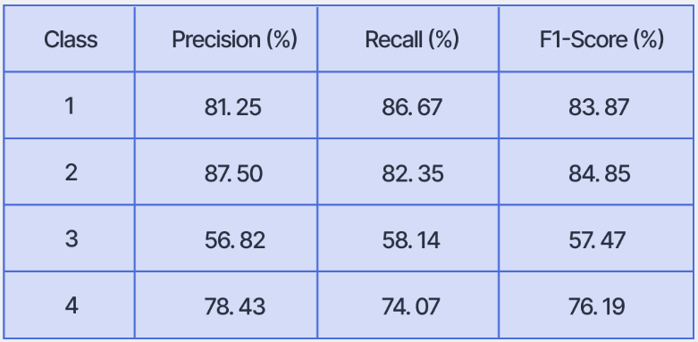
Macro F1-Score
The macro-averaged scores are calculated for each class individually, and then the unweighted mean of the measures is calculated to calculate the net global score. For the example we have been using, the scores are obtained as the following:
The unweighted means of the measures are obtained to be:
Macro Precision = 76.00%
Macro Recall = 75.31%
Macro F1-Score = 75.60%

Slide 17
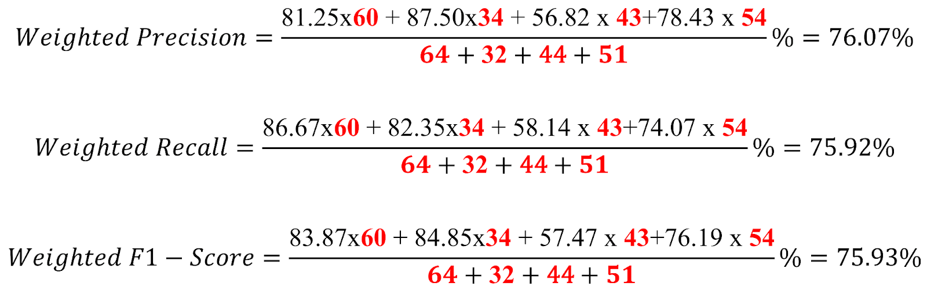
Weighted F1-Score
The weighted-average scores take a sample-weighted mean of the class-wise scores obtained. So, the weighted scores obtained are:

Slide 18
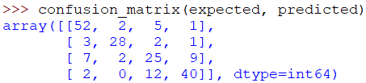
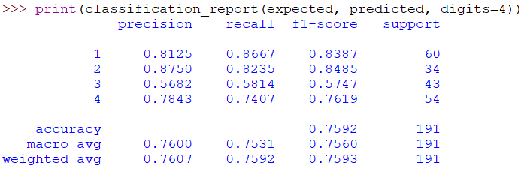
Python for Computing a Confusion Matrix
Use scikit-learn library:

Slide 19
Reference
https://www.v7labs.com/blog/confusion-matrix-guide

